Slide 1



Slide 2
Chapter 1 – Introductory Concepts

Slide 3
Chapter 1 Objectives
Selected areas covered in this chapter:
  Analog & digital representations.
    How information is represented using two states.
  Advantages/drawbacks of digital/analog techniques.
    Analog-to-digital and digital-to-analog converters.
  Basic characteristics of the binary number system.
    Convert binary numbers to decimal equivalents.
  Identify typical digital signals & a timing diagram.
  Differences between parallel & serial transmission.
  Major parts of a digital computer, their functions.
    Properties of memory.
  Distinguish among microcomputers, micro-processors, and micro-controllers.
Digital Systems: Principles and Applications, 11/e
Ronald J. Tocci, Neal S. Widmer, Gregory L. Moss

Slide 4
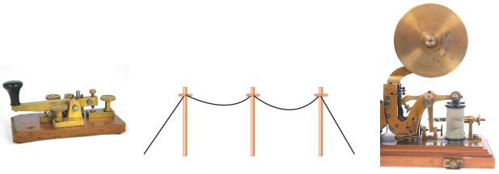
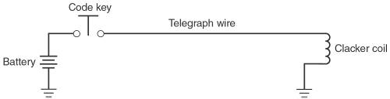
1-1 Introduction to Digital 1s and 0s
A large part of the worldwide telecommunications system falls in the category of “digital systems.”
  It started as a simple digital system that used only
  two states to represent information.
A telegraph system consisted of a battery, a code key (normally open,
momentary contact switch), a telegraph wire, and an electromagnetic “clacker.”
Digital Systems: Principles and Applications, 11/e
Ronald J. Tocci, Neal S. Widmer, Gregory L. Moss

Slide 5
1-1 Introduction to Digital 1s and 0s
The telegraph system used two distinct “symbols” to transmit any word or number.
  Short & long electric pulses, the dots & dashes of Morse code—a digital representation of information.
The electric signal is either on or off at all times.
  This relates to modern digital systems that use electrical signals to represent 1s and 0s.
Digital Systems: Principles and Applications, 11/e
Ronald J. Tocci, Neal S. Widmer, Gregory L. Moss

Slide 6
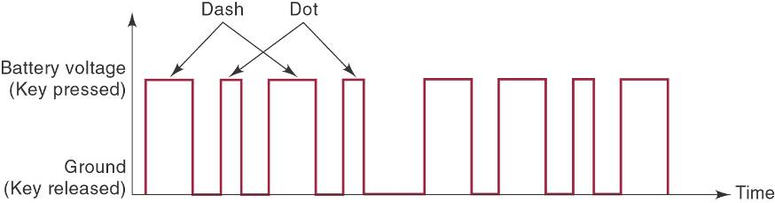
1-1 Introduction to Digital 1s and 0s
A timing diagram shows which state (1 or 0) the system is in at any point in time.
  And shows the time when a change in state occurs.
Digital Systems: Principles and Applications, 11/e
Ronald J. Tocci, Neal S. Widmer, Gregory L. Moss

Slide 7
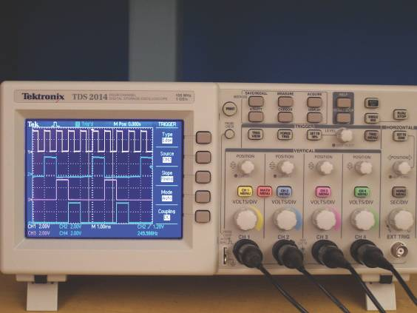
1-1 Introduction to Digital 1s and 0s
By displaying one or more digital signals using test instruments such as an oscilloscope, we can compare actual signals to expected operation.
Digital Systems: Principles and Applications, 11/e
Ronald J. Tocci, Neal S. Widmer, Gregory L. Moss

Slide 8
1-2 Numerical Representations
Physical systems use quantities which must be manipulated arithmetically.
Quantities may be represented numerically in either analog or digital form.
Digital Systems: Principles and Applications, 11/e
Ronald J. Tocci, Neal S. Widmer, Gregory L. Moss

Slide 9
1-2 Numerical Representations
Analog Representation—a continuously variable, proportional indicator.
  Sound through a microphone causes voltage changes.
  Automobile speedometer changes with speed.
  Mercury thermometer varies over a range of values with temperature.
Digital Systems: Principles and Applications, 11/e
Ronald J. Tocci, Neal S. Widmer, Gregory L. Moss

Slide 10
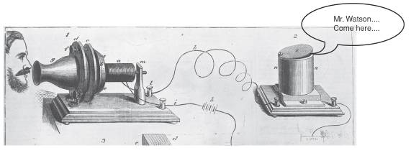
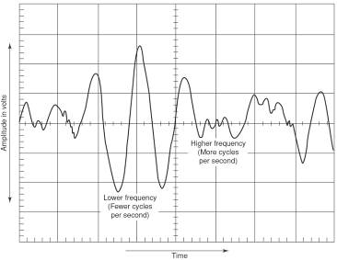
1-2 Numerical Representations
In 1875, Alexander Graham Bell figured out how to change his voice into a continuously variable electrical signal, send it through a wire, and change it back to sound energy at the other end.
Today, the device that converts sound energy to an analog voltage signal is known as a microphone.
Digital Systems: Principles and Applications, 11/e
Ronald J. Tocci, Neal S. Widmer, Gregory L. Moss

Slide 11
1-2 Numerical Representations
Digital Representation—varies in discrete (separate) steps.
  Passing time is shown as a change in the display
  on a digital clock at one minute intervals.
  A change in temperature is shown on a digital
  display only when the temperature changes
  at least one degree.
Digital Systems: Principles and Applications, 11/e
Ronald J. Tocci, Neal S. Widmer, Gregory L. Moss

Slide 12
1-3 Digital and Analog Systems
Digital system:
  A combination of devices that manipulate values represented in digital form.
Analog system:
  A combination of devices that manipulate values represented in analog form.
Digital Systems: Principles and Applications, 11/e
Ronald J. Tocci, Neal S. Widmer, Gregory L. Moss

Slide 13
1-3 Digital and Analog Systems
Advantages of digital:
  Ease of design
  Well suited for storing information.
  Accuracy and precision are easier to maintain.
  Programmable operation.
  Less affected by noise.
  Ease of fabrication on IC chips.
Digital Systems: Principles and Applications, 11/e
Ronald J. Tocci, Neal S. Widmer, Gregory L. Moss

Slide 14
1-3 Digital and Analog Systems
There are limits to digital techniques:
  The analog nature of the world requires a time consuming conversion process:
      Convert the physical variable to an electrical signal (analog).
      Convert the analog signal to digital form.
      Process (operate on) the digital information.
      Convert the digital output back to real-world analog form.
Digital Systems: Principles and Applications, 11/e
Ronald J. Tocci, Neal S. Widmer, Gregory L. Moss

Slide 15
1-3 Digital and Analog Systems
A digital system is a combination of devices designed to manipulate logical information or physical quantities represented in digital form.
  Quantities can take on only discrete values.
An analog system manipulates physical quantities represented in analog form.
  Quantities can vary over a continuous range
  of values.
Digital Systems: Principles and Applications, 11/e
Ronald J. Tocci, Neal S. Widmer, Gregory L. Moss

Slide 16
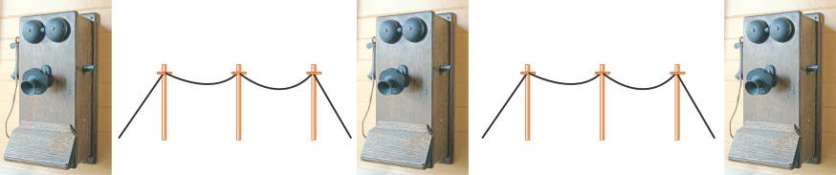
1-3 Digital and Analog Systems
Party-line callers encoded a person’s ID by the way they cranked their telephone.
The signaling (rings) used digital representation,
but voice communication was purely analog.
Digital Systems: Principles and Applications, 11/e
Ronald J. Tocci, Neal S. Widmer, Gregory L. Moss

Slide 17
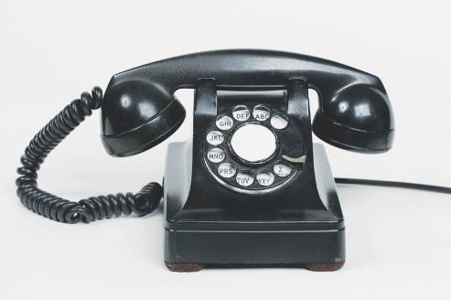
1-3 Digital and Analog Systems
The rotary-dial phone used a series of pulses, representing the ten decimal digits.
In “touch-tone” phones, digital switching information is sent using analog tone signals.
Digital Systems: Principles and Applications, 11/e
Ronald J. Tocci, Neal S. Widmer, Gregory L. Moss

Slide 18
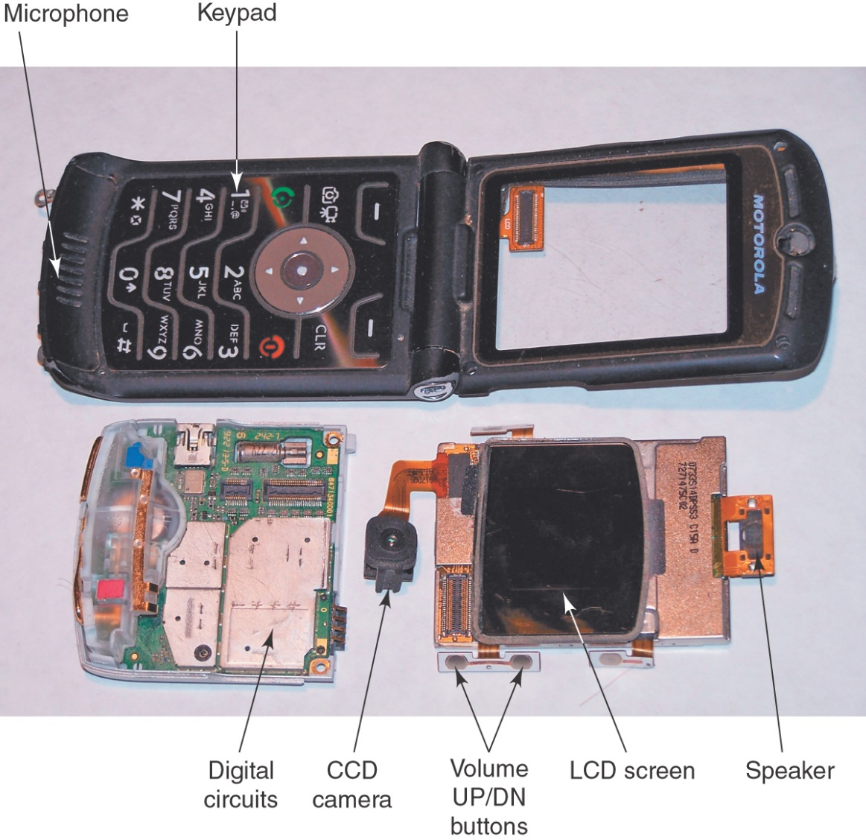
1-3 Digital and Analog Systems
The cell phone has digital & analog components, and uses both types of signals.
Digital Systems: Principles and Applications, 11/e
Ronald J. Tocci, Neal S. Widmer, Gregory L. Moss

Slide 19
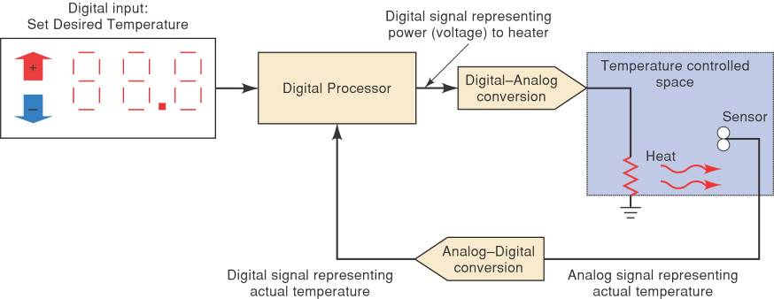
1-3 Digital and Analog Systems
Temperature-regulation system
using an analog-to-digital converter.
Digital Systems: Principles and Applications, 11/e
Ronald J. Tocci, Neal S. Widmer, Gregory L. Moss

Slide 20
1-3 Digital and Analog Systems
Chief reasons for the shift to digital technology:
  Digital systems are generally easier to design.
  Information storage is easy.
  Accuracy and precision are easier to maintain throughout the system.
  Operations can be programmed.
  Digital circuits are less affected by noise.
  More digital circuitry can be fabricated on IC chips.
There have been remarkable recent
advances in digital technology.
Advances will continue as digital
technology expands and improves.
Digital Systems: Principles and Applications, 11/e
Ronald J. Tocci, Neal S. Widmer, Gregory L. Moss

Slide 21
1-4 Digital Number Systems
Understanding digital systems requires an understanding of the decimal, binary, octal,
and hexadecimal numbering systems.
  Decimal – 10 symbols (base 10)
  Hexadecimal – 16 symbols (base 16)
  Octal – 8 symbols (base 8)
  Binary – 2 symbols (base 2)
Digital Systems: Principles and Applications, 11/e
Ronald J. Tocci, Neal S. Widmer, Gregory L. Moss

Slide 22
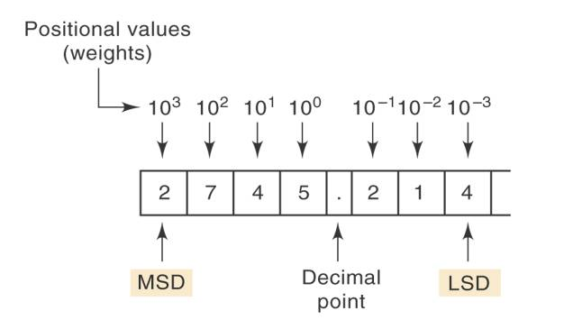
1-4 Digital Number Systems
The Decimal (base 10) System
  10 symbols: 0, 1, 2, 3, 4, 5, 6 , 7, 8, 9.
    Each number is a digit (from Latin for finger).
Most significant digit (MSD) & least significant digit (LSD).
Positional value may be stated as a digit multiplied by a power of 10.
Digital Systems: Principles and Applications, 11/e
Ronald J. Tocci, Neal S. Widmer, Gregory L. Moss

Slide 23
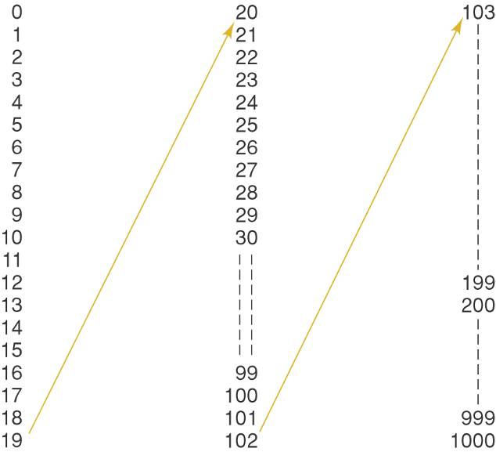
1-4 Digital Number Systems
Decimal
Counting
Digital Systems: Principles and Applications, 11/e
Ronald J. Tocci, Neal S. Widmer, Gregory L. Moss

Slide 24
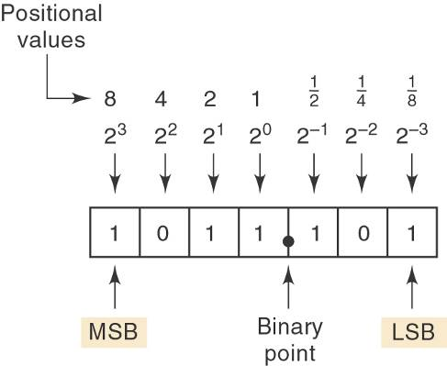
1-4 Digital Number Systems
The Binary (base 2) System
  2 symbols: 0,1
    Lends itself to electronic circuit design since only
    two different voltage levels are required.
Positional value may
be stated as a digit multiplied by a
power of 2.
Digital Systems: Principles and Applications, 11/e
Ronald J. Tocci, Neal S. Widmer, Gregory L. Moss

Slide 25
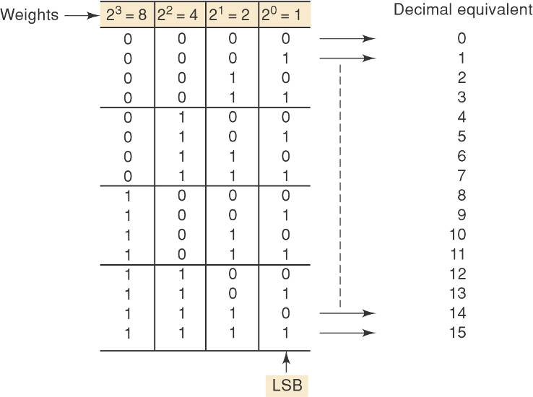
1-4 Digital Number Systems
Binary
Counting
Digital Systems: Principles and Applications, 11/e
Ronald J. Tocci, Neal S. Widmer, Gregory L. Moss

Slide 26
1-5 Representing Binary Quantities
Analog signals can be converted to digital by taking measurements or “samples” of the continuously varying signal at regular intervals.
  Appropriate time between samples depends on
  the maximum rate of change of the analog signal.
Digital Systems: Principles and Applications, 11/e
Ronald J. Tocci, Neal S. Widmer, Gregory L. Moss

Slide 27
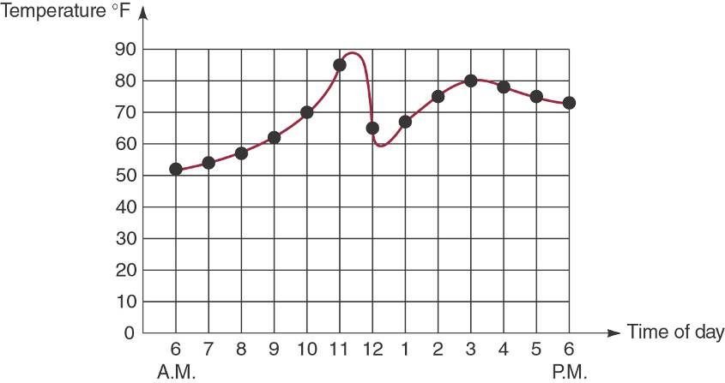
1-5 Representing Binary Quantities
Air temperature is an analog quantity.
  Recorded samples are discrete integer data.
Digital Systems: Principles and Applications, 11/e
Ronald J. Tocci, Neal S. Widmer, Gregory L. Moss

Slide 28
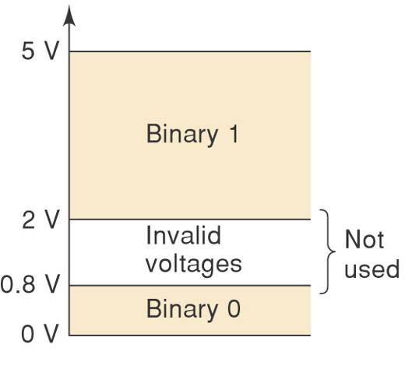
1-5 Representing Binary Quantities
Typical representation of the
two states of a digital signal.
A higher range of voltages represent a valid 1 and
a lower range of voltages represent a valid 0.
HIGH and LOW are often used to describe the states
of a digital system—instead
of “1” and “0”
Digital Systems: Principles and Applications, 11/e
Ronald J. Tocci, Neal S. Widmer, Gregory L. Moss

Slide 29
1-5 Representing Binary Quantities
Two state devices:
  Light bulb (off or on)
  Diode (conducting or not conducting)
  Relay (energized or not energized)
  Transistor (cutoff or saturation)
  Photocell (illuminated or dark)
Digital Systems: Principles and Applications, 11/e
Ronald J. Tocci, Neal S. Widmer, Gregory L. Moss

Slide 30
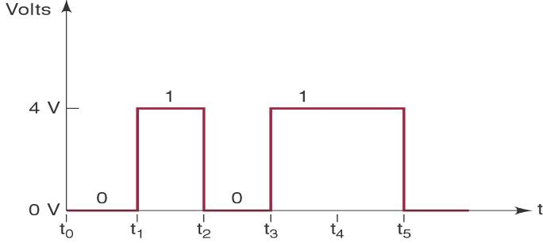
1-5 Representing Binary Quantities
The oscilloscope and logic analyzer are used to produce timing diagrams.
  Timing diagrams show voltage versus time.
    Used to show how digital signals change with time,
    or to compare two or more digital signals.
Horizontal scale represents regular intervals, starting
at time zero.
Digital Systems: Principles and Applications, 11/e
Ronald J. Tocci, Neal S. Widmer, Gregory L. Moss

Slide 31
1-6 Digital Circuits/Logic Circuits
Digital circuits - produce & respond to predefined voltage ranges.
  The term logic circuits is used interchangeably.
Digital Systems: Principles and Applications, 11/e
Ronald J. Tocci, Neal S. Widmer, Gregory L. Moss

Slide 32
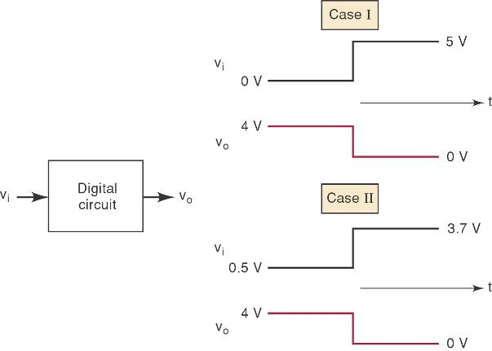
1-6 Digital Circuits/Logic Circuits
A digital circuit responds to an input’s binary level of 0 or 1—not to its actual voltage.
Digital Systems: Principles and Applications, 11/e
Ronald J. Tocci, Neal S. Widmer, Gregory L. Moss

Slide 33
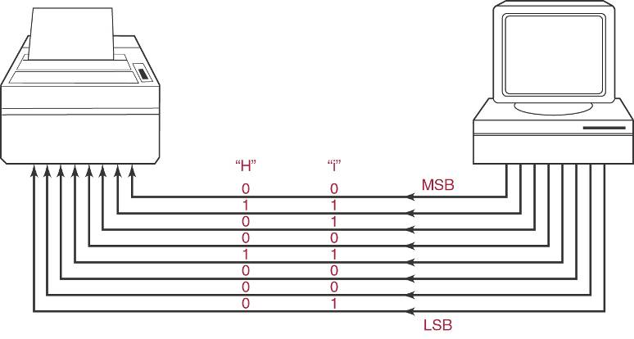
1-7 Parallel and Serial Transmission
Parallel transmission – all bits in a binary number are transmitted simultaneously.
  A separate line is required for each bit.
Digital Systems: Principles and Applications, 11/e
Ronald J. Tocci, Neal S. Widmer, Gregory L. Moss

Slide 34
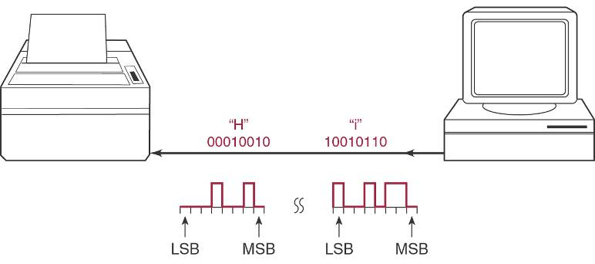
1-7 Parallel and Serial Transmission
Serial transmission – each bit in a binary number is transmitted, per some time interval.
Digital Systems: Principles and Applications, 11/e
Ronald J. Tocci, Neal S. Widmer, Gregory L. Moss

Slide 35
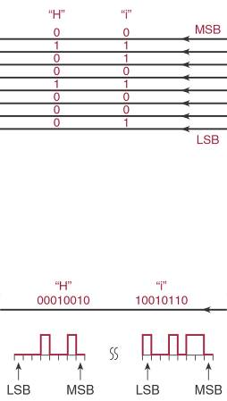
1-7 Parallel and Serial Transmission
Parallel transmission is faster but
requires more paths.
Serial is slower but requires a single path.
Digital Systems: Principles and Applications, 11/e
Ronald J. Tocci, Neal S. Widmer, Gregory L. Moss

Slide 36
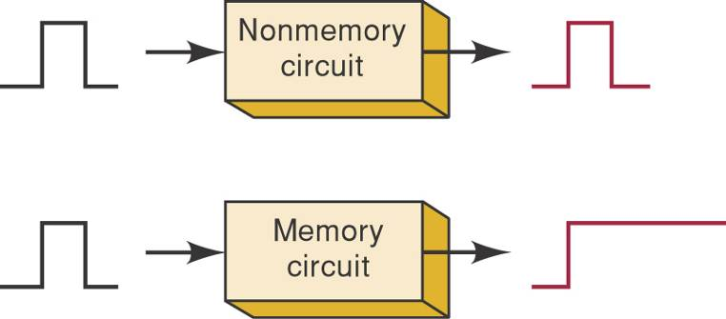
1-8 Memory
A circuit which retains a response to a momentary input is displaying memory.
  Memory is important because it provides a way to store binary numbers temporarily or permanently.
Memory elements: magnetic, optical, electronic latching circuits.
Digital Systems: Principles and Applications, 11/e
Ronald J. Tocci, Neal S. Widmer, Gregory L. Moss

Slide 37
1-9 Digital Computers
A computer is a system of hardware that performs arithmetic operations, manipulates data, and makes decisions.
  Performs operations based on instructions in the
  form of a program at high speed, and with a high degree of accuracy.
Digital Systems: Principles and Applications, 11/e
Ronald J. Tocci, Neal S. Widmer, Gregory L. Moss

Slide 38
1-9 Digital Computers
Major parts of a computer:
  Input unit—Processes instructions and data
  into the memory.
  Memory unit—Stores data and instructions.
  Control unit—Interprets instructions and sends appropriate signals to other units as instructed.
  Arithmetic/logic unit—arithmetic calculations
  and logical decisions are performed.
  Output unit—presents information from the
  memory to the operator or process.
Digital Systems: Principles and Applications, 11/e
Ronald J. Tocci, Neal S. Widmer, Gregory L. Moss

Slide 39
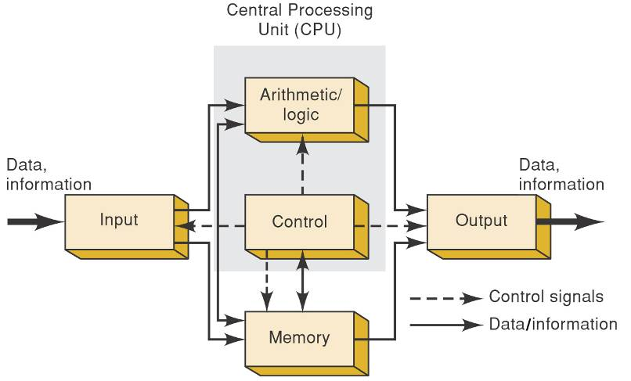
1-9 Digital Computers
The control and arithmetic/logic units are often treated
as one and called the central processing unit (CPU).
Digital Systems: Principles and Applications, 11/e
Ronald J. Tocci, Neal S. Widmer, Gregory L. Moss

Slide 40
1-9 Digital Computers
Types of computers:
  Microcomputer.
    Most common (desktop PCs).
    Has become very powerful.
  Minicomputer (workstation).
  Mainframe.
  Microcontroller.
    Designed for a specific application.
    Dedicated or embedded controllers.
    Used in appliances, manufacturing processes, auto ignition systems, ABS systems, and many other applications.
Digital Systems: Principles and Applications, 11/e
Ronald J. Tocci, Neal S. Widmer, Gregory L. Moss

Slide 41
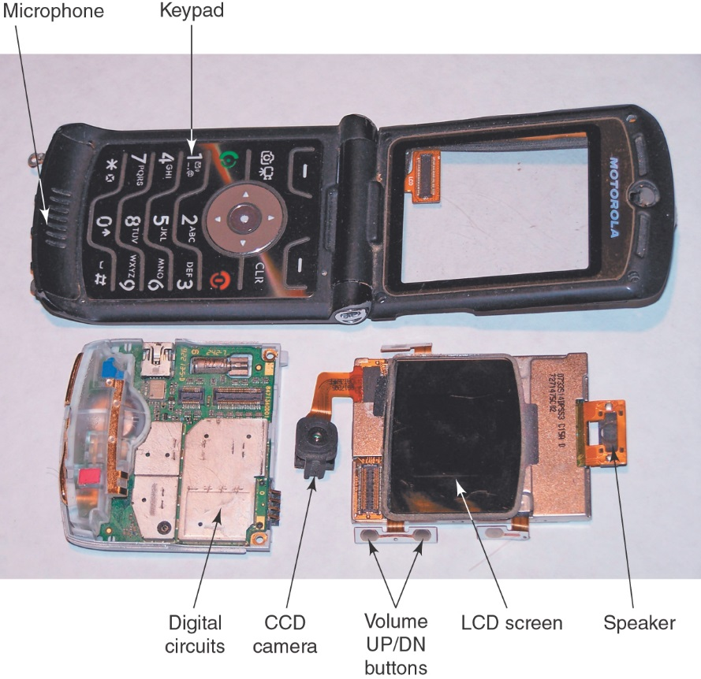
1-9 Digital Computers
The basic functions of the digital subsystems of a cell phone—and all other built-in applications—are controlled by a complete microcomputer system embedded in each phone.
Digital Systems: Principles and Applications, 11/e
Ronald J. Tocci, Neal S. Widmer, Gregory L. Moss

Slide 42
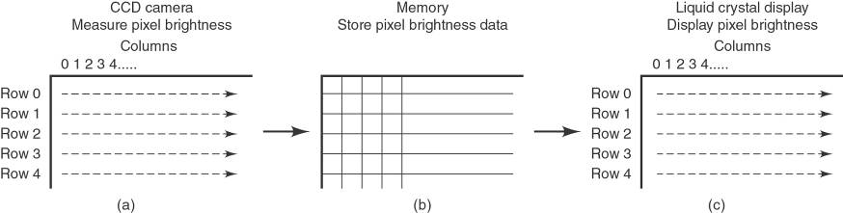
1-9 Digital Computers
When you take a picture, the phone convert the brightness
of individual spots in the CCD to binary numbers, and
stores it in memory (row x, column x).
Displaying the image on an LCD screen is the
reverse process of storing an image in memory.
Digital Systems: Principles and Applications, 11/e
Ronald J. Tocci, Neal S. Widmer, Gregory L. Moss

Slide 43
1-9 Digital Computers
When you speak into your phone, the voice signal is converted to a string of digital (binary) numbers.
  Signals get separated and routed to the proper place by digital multiplexers and demultiplexers.
Digital Systems: Principles and Applications, 11/e
Ronald J. Tocci, Neal S. Widmer, Gregory L. Moss

Slide 44
Digital Progress Today and Tomorrow
There are many needs in the world that digital technology can meet.
  You will be able to become one of the pioneers on these new frontiers of technology.
Digital Systems: Principles and Applications, 11/e
Ronald J. Tocci, Neal S. Widmer, Gregory L. Moss

Slide 45
END

